Slide 1
Azhar Khan Chief Financial Officer, QIB (UK)
Islamic Banking:
A Gateway to Opportunity
The 4th Biennial International Business, Banking &
Finance Conference, Trinidad and Tobago 24 June 2011

Slide 2
QIB (UK) - Part of the QIB Banking Group
Qatar Islamic Bank (QIB)
QIB is one of the largest Islamic banks in the world with global operations in 4 Islamic financial markets: Qatar, UK, Malaysia and Lebanon
QIB has a proven track record of developing and implementing Shari’a compliant financial solutions for over 28 years
The short term and long term Fitch rating of QIB is F1 and A respectively
QIB is the largest Islamic Bank in Qatar, with around 50% market share in the country’s Islamic banking sector
Provides global reach to evolving opportunities

Slide 3
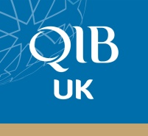
Scope - The QIB (UK) Experience
Islamic Banking products can be used across the spectrum of Investment Banking
Diverse market and investor base
Asset Management
Corporate Finance
Real Estate
Treasury
Mutual funds
Private equity
Investment products
Financing
Capital raising
Sukuk issuance
Trade Finance
Investment & advisory services
Financing
Deposit taking
Forex
Asset / Liability management
HNWI’s Wholesale Corporates Treasury

Slide 4
The Opportunities
Broaden market reach domestically
Build profile internationally
Access wider liquidity and capital markets
Diversified investor base
Sustainable partnerships based on sharing of risks and reward
Commercially viable products that are accessible and provide an additional option to all segments of the customer base

Slide 5
Financing Examples
Leasing acquisition - e.g. Aircraft, manufacturing plant and equipment
£50m capital raising mandate for UK manufacturing group
Clothing retailer expansion - £5m working capital facility to support growth
Fast Food restaurant chain - £1m to support expansion plans
£7m expansion financing for healthcare manufacturing company

Slide 6
General Electric – Capital Raising
5 year Sukuk issue in 2009
US$500 million capital raising
Funding for financing aircraft assets
Access to a completely new source of funding

Slide 7
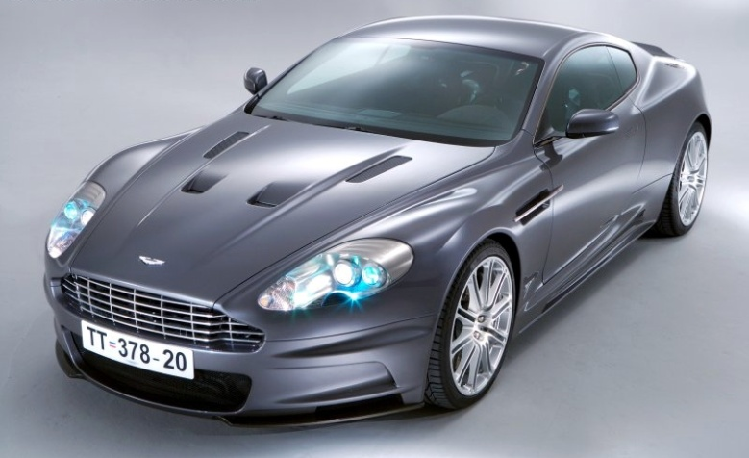
Purchase of Aston Martin Motor Company
Purchase of Aston Martin from Ford in 2007
Total cost of almost £500 million included £225 million of finance structured islamically
Arranged by West LB
Diversified funding base

Slide 8
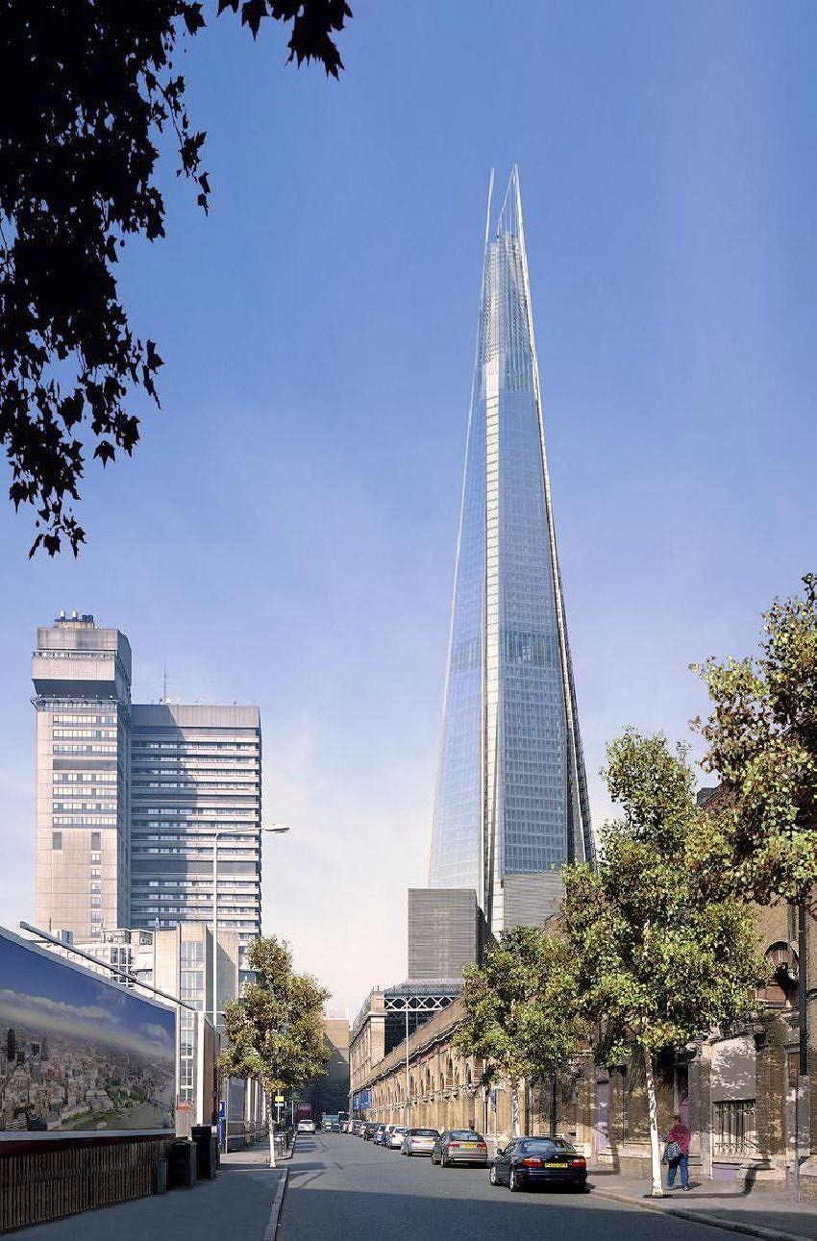
Shard Tower London
Due for completion in 2012
Will be tallest tower in Europe
Partly financed using Islamic financing
Co-existence of financing structures

Slide 9
Conclusion
Global industry
Diversification of market and funding base
Commercially viable alternative
Opportunities on domestic, regional and international levels
Thank you
Azhar Khan
Chief Financial Officer
QIB(UK)
akhan@qib-uk.com

